Slide 1

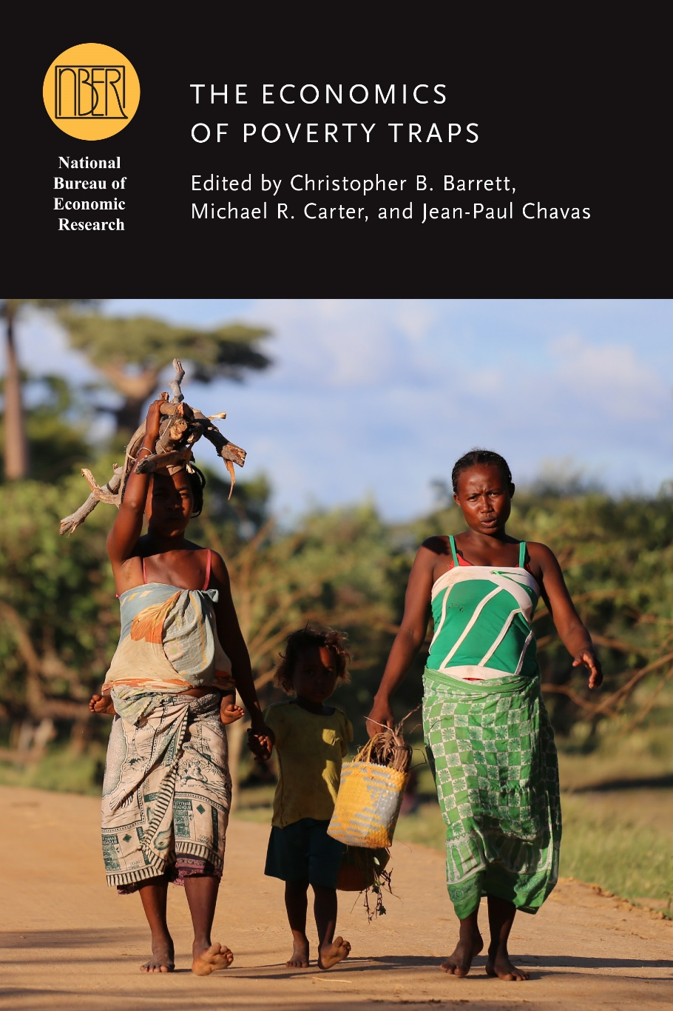
Private enterprise’s role in facilitating escapes from poverty traps
Chris Barrett
March 26, 2019 presentation to
Social Enterprise Group at Cornell

Slide 2
Poverty traps
Poverty traps: self-reinforcing feedback that poor ‘initial conditions’ lead to optimal behaviors that perpetuate poverty.
Ex:
- malnutrition causes poverty, which leads to malnutrition.
- high risk exposure leads to risk averse livelihood strategies that lock in poverty
- financial stress induces cognitive errors that hurt financial performance
- poverty increases trauma risk; but trauma harms mental health, thus productivity.
But vicious cycles of reinforcing feedback also suggest virtuous cycles … if traps exist, then escapes possible!

Slide 3
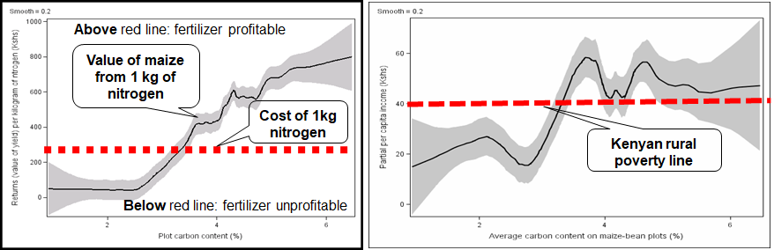
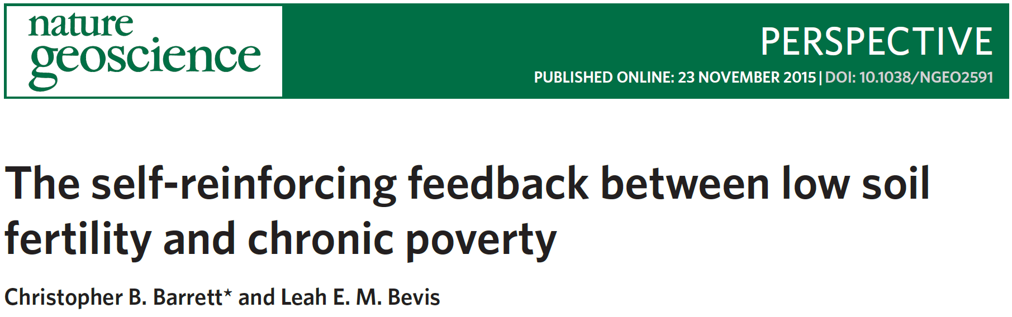
Fertilizer, soils, poverty in Kenya:
Fertilizer less beneficial on poor soils. The poor cultivate poorer soils. So less likely to apply fertilizer. Thus lower yields and incomes, reinforcing poverty.
Poverty traps examples
Soil mineral content and diets
Zinc, iron, selenium, etc. come from soils. Micronutrient deficiencies affect 2-3 bn people. Hurt soil/human productivity.
Sources: Marenya and Barrett (AJAE 2009; Ag Econ 2009), Barrett and Bevis (Nature Geoscience 2015)

Slide 4
Turning slaughtered animals’ bones into P fertilizer in Ethiopia:
Prospective solutions
Source: Simons, Blalock & Nesin (2018)

Slide 5
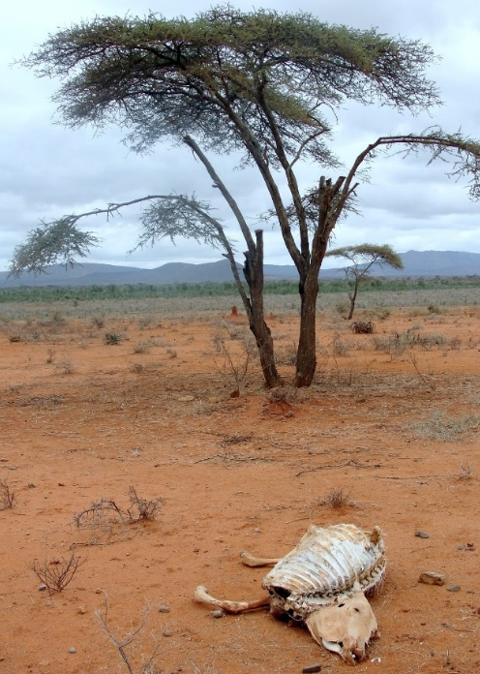
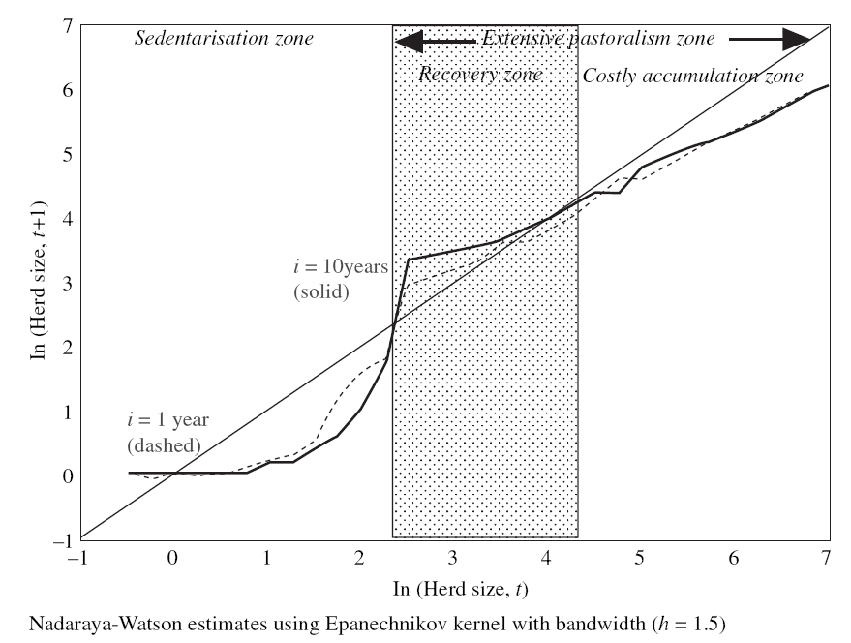
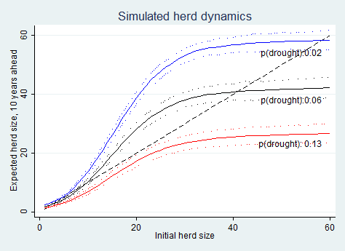
Poverty traps examples
Herders and drought in Ethiopia and Kenya:
When droughts hit, even able pastoralists may be unable to recover. If drought frequency grows, system collapse becomes likely, trapping entire communities.
Further, usual responses (food aid, restocking) slow and low return. Need innovative responses to break the vicious cycle and foster escapes.
Sources : Lybbert et al. (EJ 2004), Barrett and Santos (Ecol Econ 2014), Santos and Barrett (NBER/UCP 2018)

Slide 6
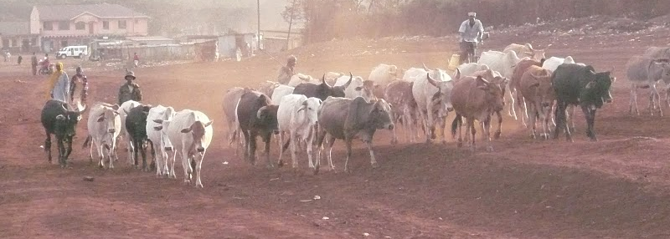
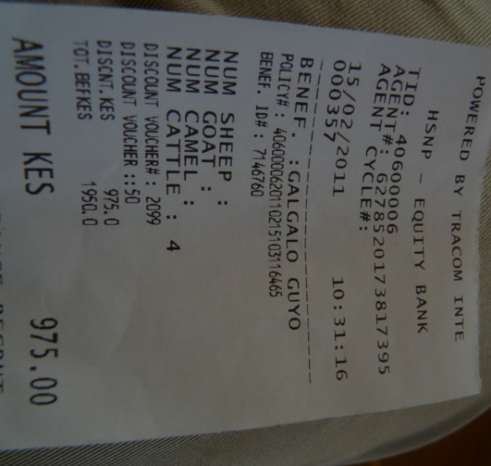
Prospective solutions
Index-based livestock insurance to protect vs. drought
Individuals buy policies to protect their herds
Private underwriters, global reinsurers
Commercial pilot in Kenya in 2010; big win in 2011 drought
Now spread to Ethiopia, nationwide in Kenya
Reduced adverse coping strategies among insured
Major, positive effects in both countries: 12-20x the marginal benefit/cost of cash transfer programs
Sources: Chantarat et al. (JRI 2013); Jensen et al. (JDE 2017); Janzen and Carter (AJAE 2018); Tafere et al. (AJAE in press)

Slide 7
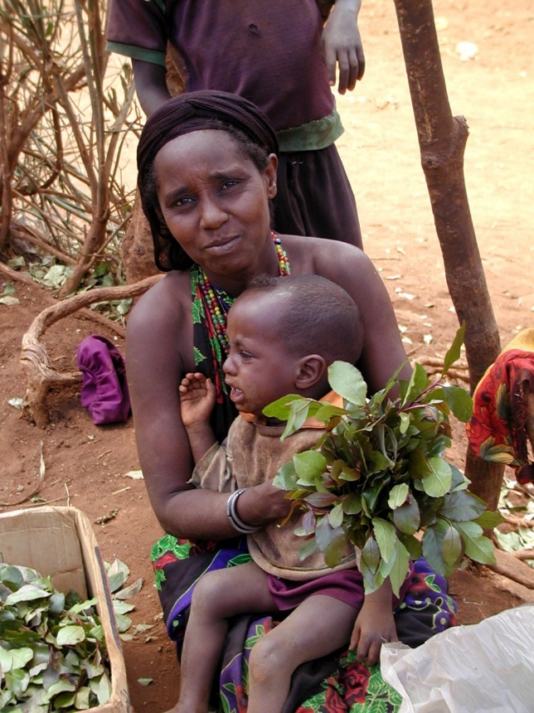
Poverty traps examples
Multidimensional poverty:
Poor rural women often lack investible capital, skills, and social connections. Must provide for family’s immediate needs.
Financial, skills, and social barriers simultaneously bind and impede economic advance

Slide 8
Prospective solutions
BRAC Targeting Ultra Poor program in Bangladesh
Targeted at poorest women: provide cash/consumption support, skills training, coaching, and productive asset transfer
After 2/7 years: assets (net of transfers) up 55/435% !! Access to land and livestock, consumption expenditures all improve dramatically. Benefit/cost ratio ~5.4; annual internal rate of return averaged 22%
Replicated in multiple other countries worldwide, with significant gains in food security, mental health, asset ownership, work, etc.
Sources : Banerjee et al. (Science 2015), Bandiera et al. (QJE 2017), Ikegami et al. (NBER/UCP 2018)

Slide 9
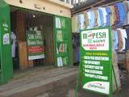
Prospective solutions
Technologies to reduce transactions costs and enhance financial access disproportionately help the poor.
In Kenya M-Pesa (mobile money):
raised ~200K households out of extreme poverty
induced ~185K women to switch into more remunerative business or retail occupations.
helped households get help in
times of need (0 vs. -7% losses)
In Niger:
reduces food price fluctuations
lowers aid delivery costs and
improves recipient nutrition
Sources : Suri & Jack (Science 2016), Jack & Suri (AER 2014), Aker (AEJ:Applied 2010), Aker et al. (EDCC 2016)

Slide 10
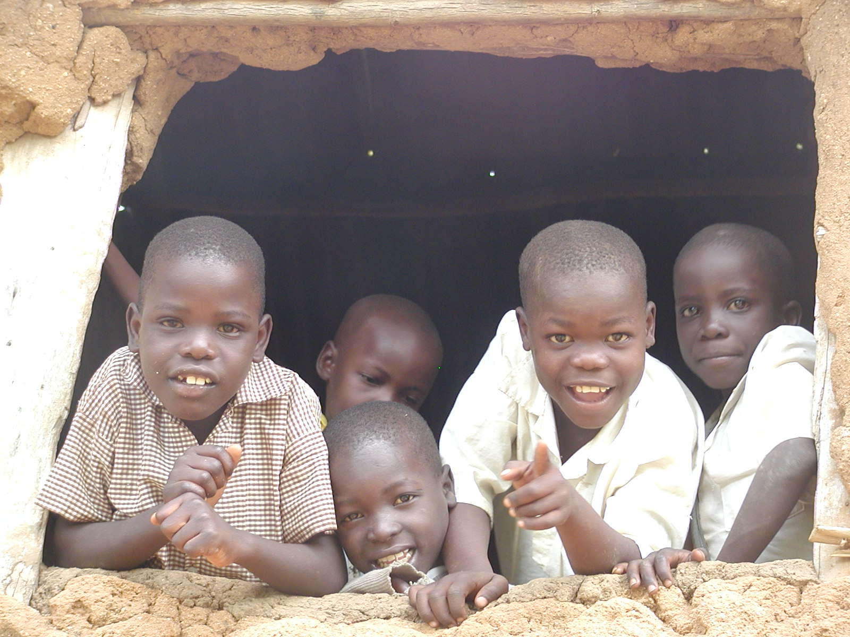
How can you help?
1. Research: hard problems solved by science
2. Solidarity: policies matter
3. Social enterprise: people will pay to solve problems
4. Charity: give but ignore slick marketing and seek
solid evidence of impact:
- Child sponsorship and education programs
Support clean water, bed nets, de-worming, oral rehydration, and immunization interventions
“Graduation” programs
Effective disaster response

Slide 11
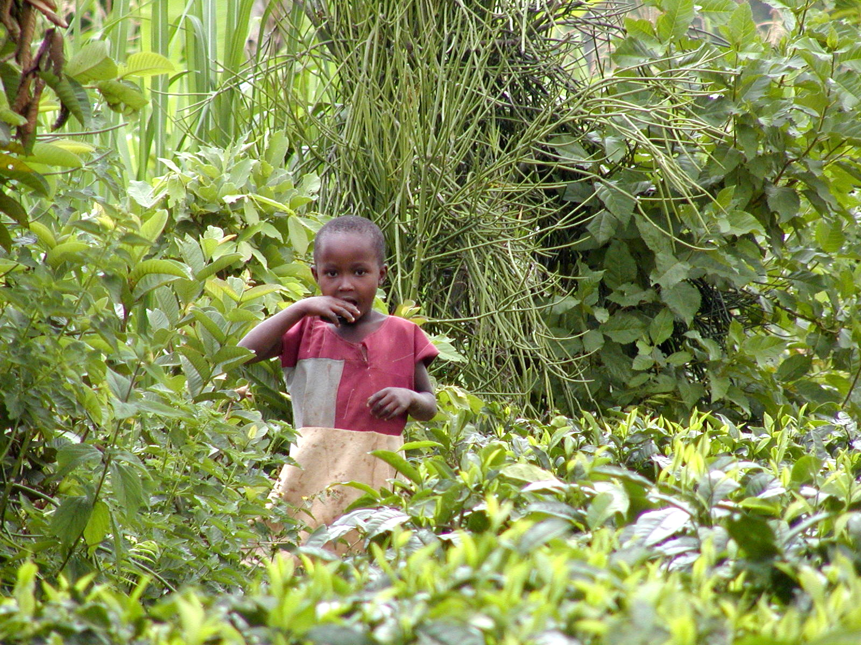
“Most of the people in the world are poor, so if we knew the economics of being poor we would know much of the economics that really matters.”
- Theodore W. Schultz
Opening sentences of 1979 Nobel Prize in Economics lecture
Cornell has great, perhaps unique, capacity to help

Slide 12
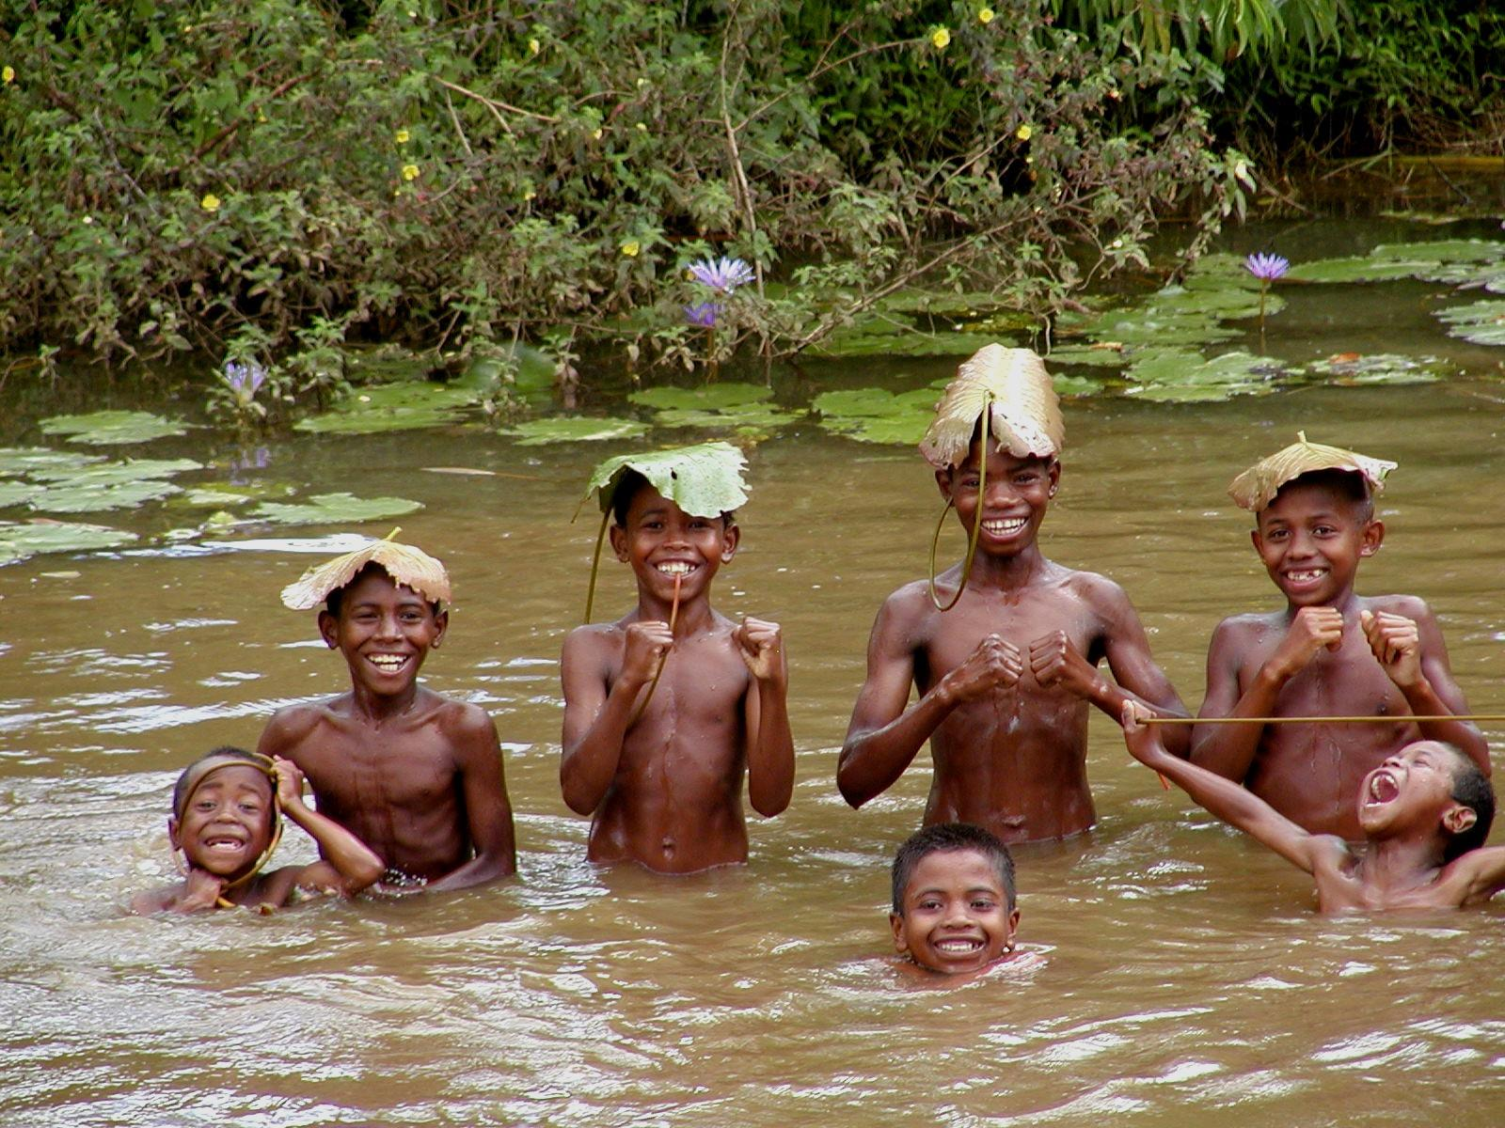
Thoughtful social enterprise can help the poor avoid or escape poverty traps

